Slide 1
Web Accessibility Recognition Scheme 2016
How to Meet the Accreditation Criteria (Website Stream)
Office of the Government Chief Information Officer
Digital Inclusion Division
30 October 2015

Slide 2
Web Accessibility Recognition Scheme
Scope of Assessment – Website Stream
Main webpage
Contact Us / What’s News webpage(s)
All first-level of webpages
Webpages for
three core businesses
Webpage 00
Restaurant Homepage
Webpage11
Online Food Order
Webpage12
Food Selection
Webpage 13
Delivery & Payment
Webpage14
Confirmation
Webpage 21
Members’ Corner
Webpage 22
Join us Registration
Webpage 23
Confirmation
Webpage 31
Latest Promotion
Webpage 32
Promotion Dishes Details
Webpage 41
Shop Location
Webpage 42
Shop List
Webpage 43
Shop Address
Webpage 51
Contact Us/ What’s New
Mock-up website hierarchy

Slide 3
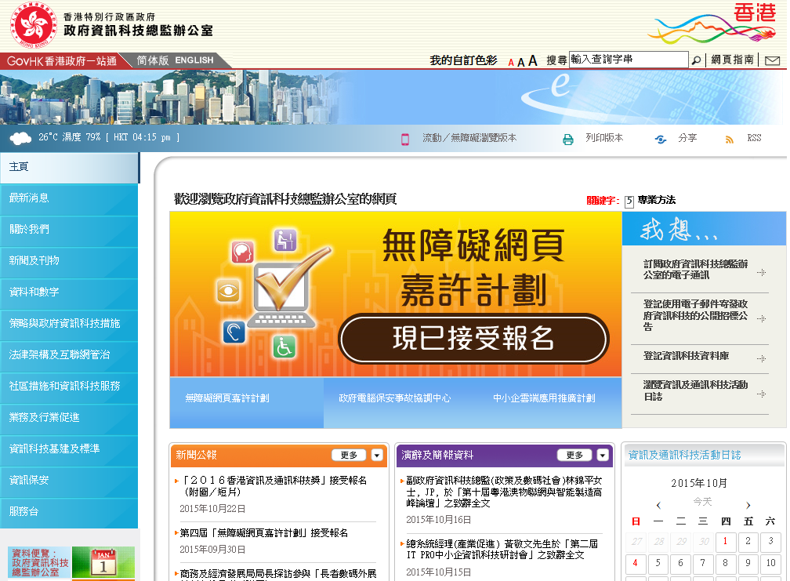
Scope of Assessment – Website Stream
1. Main webpage – www.ogcio.gov.hk
3. All first-level of webpages
2. Contact Us
4. Core business 1
5. Core business 2
6. Core business 3

Slide 4
Website Stream – Silver Criteria
Silver : 13 Judging Criteria
No. | Judging Criteria
W01 | Provide meaningful text alternative for non-text contents
W02 | Provide accessible Flash/Animated contents or allow to skip
W03 | Allow to perform all operations through a keyboard interface
W04 | Easy to turn off background sound or set as user-initiated only
W05 | Provide means to close popup windows
W06 | Provide clear and informative links
W07 | Provide accurate and appropriate headings/labels
W08 | Make website content easy to be used with assistive technologies
W09 | Make website structure in a consistent navigation mechanism
W10 | Make website content in meaningful sequence
W11 | Provide input assistance and error identification and description etc.
 | Provide error prevention for transactions
W12 | Text can be resized up to 200 percent without loss of content
W13 | Provide an accessibility statement with contact points
4

Slide 5
Website Stream – Silver Criteria
Gold : 24 Judging Criteria
No. | Judging Criteria
W14 | Provide accessible PDFs within scope of assessment published in the recent 2 years (i.e. since mid of April 2014)
W15 | Build webpages with predictable operations
W16 | Able to skip repetitive blocks
W17 | Provide multiple ways to retrieve content
W18 | Build webpages with user-initiated auto-updating
W19 | Provide sufficient time for users to read the content and operate the function
W20 | Provide sufficient colour contrast
W21 | Ensure correct syntax of webpages
W22 | Provide transcript, captions or sign language for 30% of pre-recorded videos published in the recent 2 years (i.e. since mid of April 2014)
W23 | Provide meaningful title, summary or description for table header as well as data
W24 | Provide error prevention for transactions (from Silver Award)

Slide 6
Website Stream – Gold Criteria
G01. Provide accessible PDFs (WAA2015)
For any PDF documents in the webpage, it shall provide the following accessible features, if applicable, –
  Visual presentation of text and images of text has a contrast ratio of at least 4.5:1
  Provide meaning text alternatives for images
  Ensure correct tab and reading order
  Hide decorative images with the Artifact tag
  Use table elements for table markup
  Perform OCR on a scanned PDF document to provide actual text
  Provide links and link text
  Set the default language in the document
  Specify consistent page numbering
  Specify the document title

Slide 7
Website Stream – Gold Criteria
W14. Provide accessible PDFs (WAA2016)
For any PDF documents in the webpage, it shall provide the following accessible features, if applicable, –
  Provide meaning text alternatives for images
  Ensure correct tab and reading order
  Use table elements for table markup
  Set the default language in the document
  Specify the document title

Slide 8

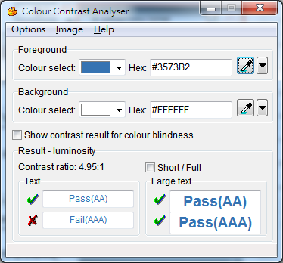
Web Accessibility Recognition Scheme
  Testing Steps
  Code Scanning (編碼掃描) / Code Review (編碼檢查)
  Total Validator Tools (www.totalvalidator.com)
  AChecker (achecker.ca/checker)
  WAVE (wave.webaim.org)
  Visual Review (目視檢查)
Colour Contrast Analyser
(www.paciellogroup.com/resources/contrastanalyser)

Slide 9

Web Accessibility Recognition Scheme
  Testing Steps
  Manual Testing with Screen Reader (使用讀屏軟件進行手動檢測)
NVDA (www.hkbu.org.hk/en_services4_2.php)
JAWS (www.freedomscientific.com/Products/Blindness/JAWS)
  Human Testing (使用者測試)

Slide 10

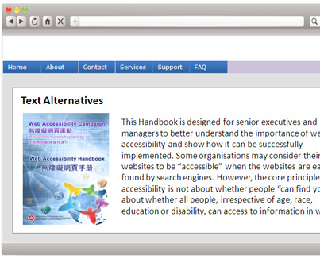
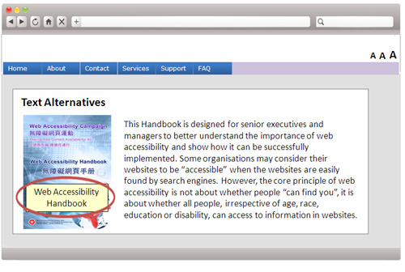
W01
((Silver Award)
1. Meaningful Text Alternative
Non-text contents, such as icons, photos, pictures, images, banners and maps, should have a text alternative
Screen reader cannot read the picture
A text description that can be read by the screen reader

Slide 11
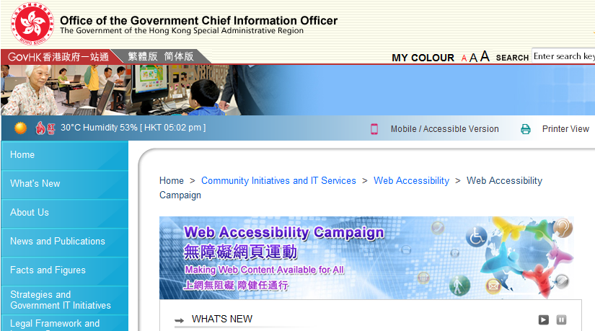
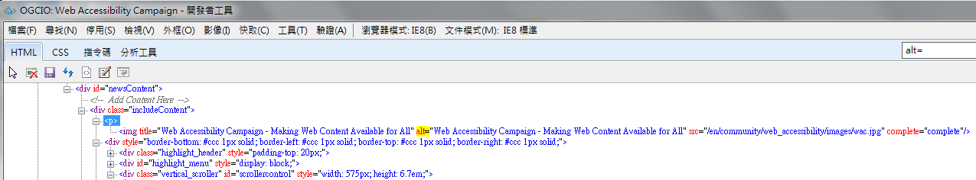
W01
((Silver Award)
1. Meaningful Text Alternative
Testing: Code Review, Manual Testing with Screen Reader
alt="Web Accessibility Campaign - Making Web Content Available for All”
Press F12 in browser software to view the code
Source : www.webforall.gov.hk/en

Slide 12



W02
((Silver Award)
2. Flash / Animated Content
Provide accessible Flash/Animated content or allow skip function
Skip
Flash content blocks the user from getting to main content
Include accessible “Skip” option allow user to skip Flash content

Slide 13

W02
((Silver Award)
2. Flash / Animated Content
Testing: Visual Review, Manual Testing with Screen Reader
Provide Accessible Button
Source : www.webforall.gov.hk/en

Slide 14
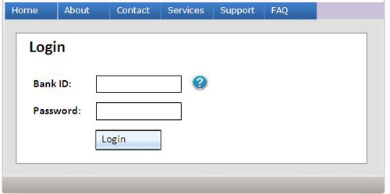

W03
((Silver Award)
3. Keyboard Interface
Functions on a webpage are operable through a keyboard interface; the operation shall not enforce a time limit for individual keystrokes
People using a keyboard interface may not be able to navigate to the help function provided
Allow users to access all content and functions with a keyboard interface

Slide 15
W03
((Silver Award)
3. Keyboard Interface
Testing: Code Review, Manual Testing with Screen Reader
Allow users to access all content and functions with a keyboard interface
Source : www.webforall.gov.hk

Slide 16
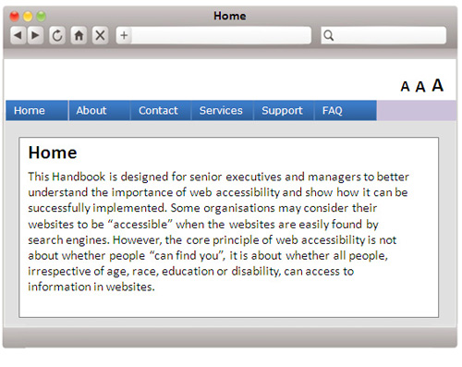
W04
((Silver Award)
4. Background Sound
If audio plays or stop automatically for more than 3 seconds, a pause function is required
About Web Accessibility -
About Web Accessibility -
Turn off background sound
The background sound will begin playing automatically in five seconds
Include a link to turn off the background sound at the beginning of the webpage

Slide 17

W04
((Silver Award)
4. Background Sound
Testing: Visual Review, Manual Testing with Screen Reader
Turn off background sound option
Source : s1.ecard.gov.hk/ecard/main

Slide 18
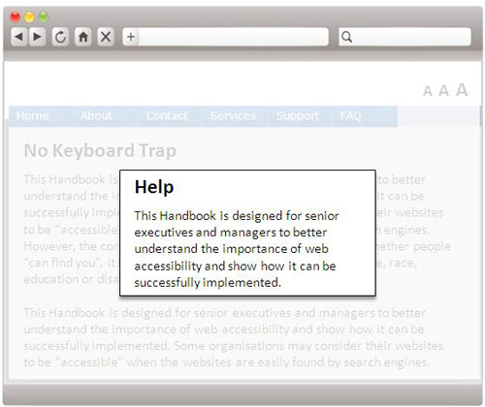
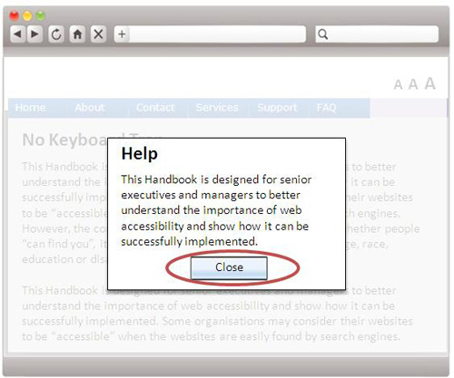
W05
((Silver Award)
5. Popup Windows
A close button to allow closing the popup window through keyboard interfaces is provided to close
No ways to close the popup window using a keyboard
Include a Close button to close the popup window

Slide 19

W05
((Silver Award)
5. Popup Windows
Testing: Visual Review, Manual Testing with Screen Reader
Close
Source : www.gov.hk

Slide 20
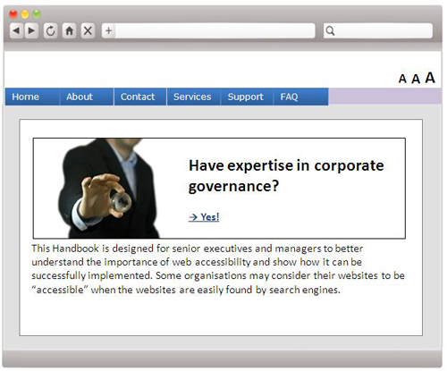
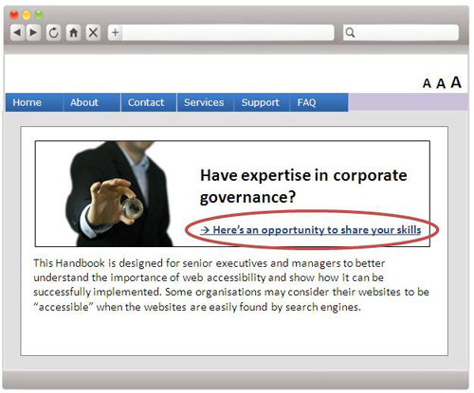
W06
((Silver Award)
6. Links
Either the link text alone or the text preceding the link is clear and meaningful
The link "Yes" is ambiguous and does not really convey much meaning
Link labels should be more descriptive and self-explanatory

Slide 21
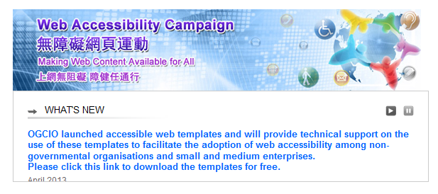
W06
((Silver Award)
6. Links
Testing: Visual Review, Manual Testing with Screen Reader
Source : www.webforall.gov.hk/en

Slide 22
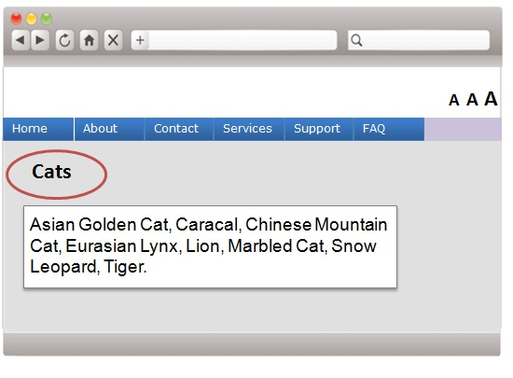
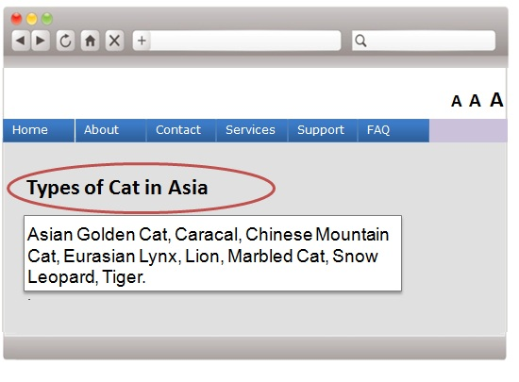
W07
((Silver Award)
7. Headings/Labels
Use clear and appropriate headings and labels
Heading does not accurately describe the purpose of the content
Detailed heading that accurately describes the content

Slide 23
W07
((Silver Award)
7. Headings/Labels
Testing: Visual Review and Human Testing

Slide 24
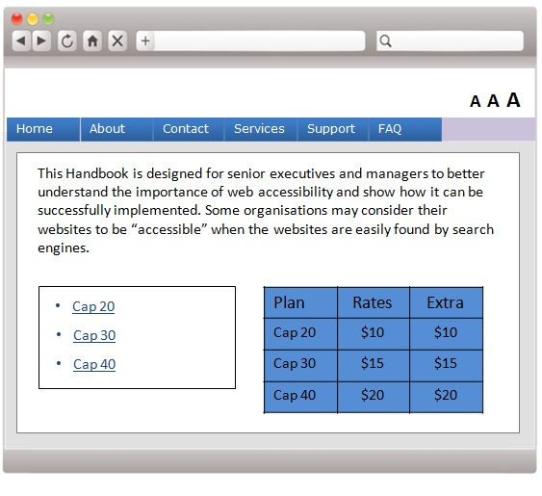
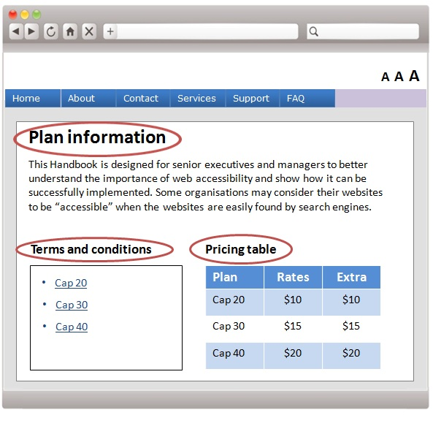
W08
((Silver Award)
8. Website Structure and Content
    Use heading mark-up (h1..h6) to identify headings in the content.
    Use heading mark-up (h1..h6) to identify headings in the content.
  Missing heading structure
  Provide semantic code for headings (h1,h2,h3) in the content

Slide 25
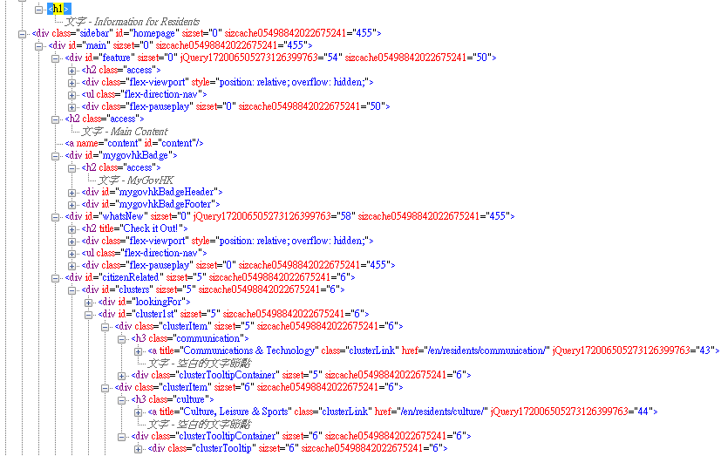
W08
((Silver Award)
8. Website Structure and Content
Testing: Code Review, Manual Testing with Screen Reader

Slide 26
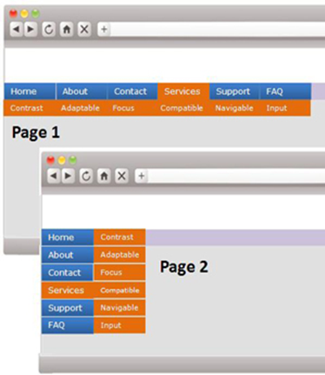
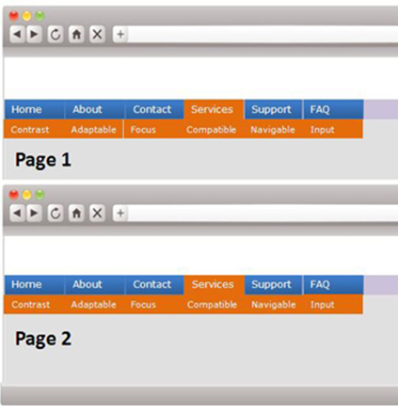
W09
((Silver Award)
9. Consistent Navigation Mechanism
    Navigational mechanism should be consistent
  The style is not consistent across multiple webpages
  Ensure the navigation is consistent across multiple webpages

Slide 27
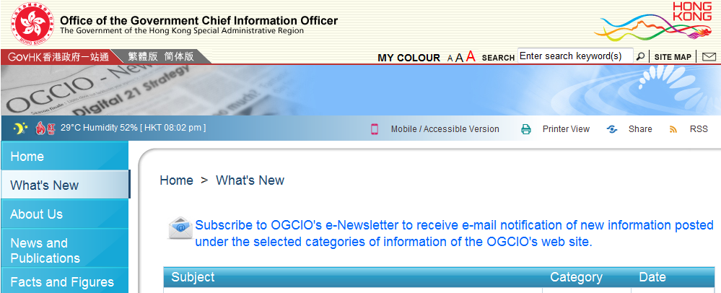
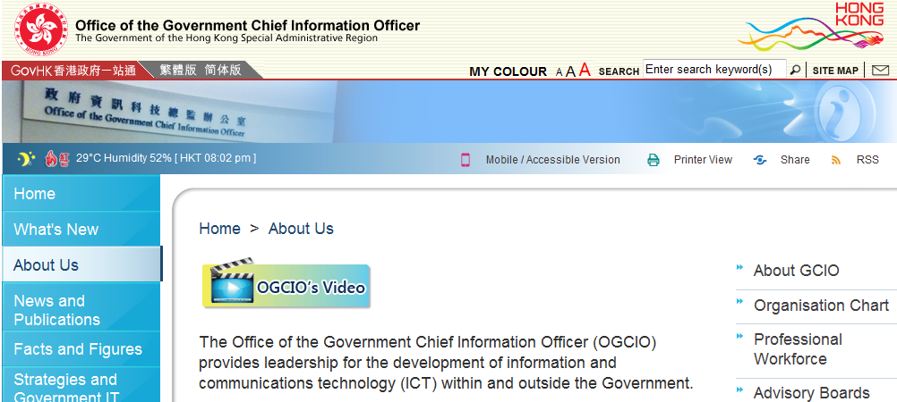
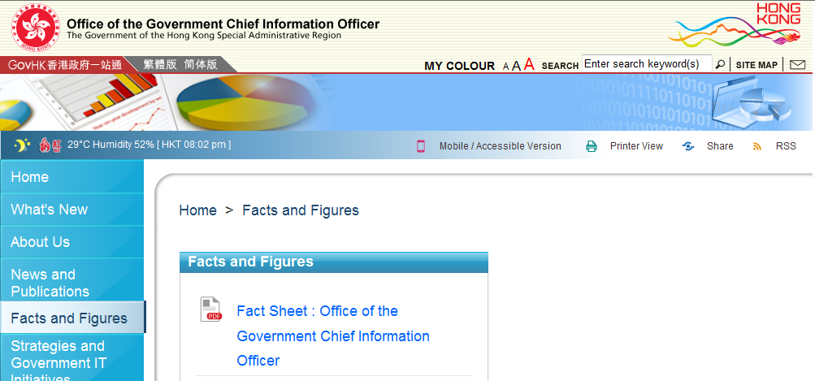
W09
((Silver Award)
9. Consistent Navigation Mechanism
Testing: Visual Review
Source : www.ogcio.gov.hk

Slide 28
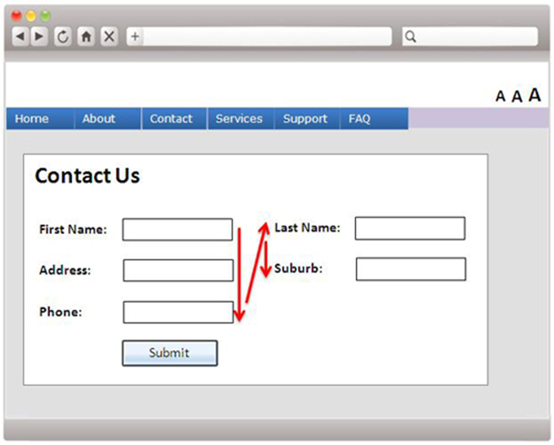
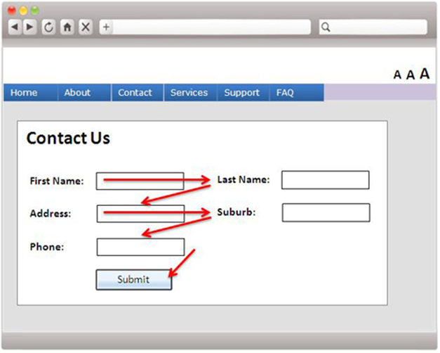
W10
((Silver Award)
10. Meaningful Sequence
If webpage content needs to be read in a certain order to make sense, webpage shall be written/coded in a way which indicates this order
Webpage, especially web form, shall be coded in a logical manner when read by screen reader
  Focus order not intuitive to user
  Focus order in logical manner

Slide 29
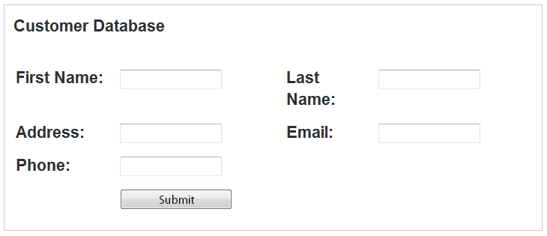
W10
((Silver Award)
10. Meaningful Sequence
Testing: Manual Testing with Screen Reader
Use a screen reader to read or press the "Tab" key to go through the input fields

Slide 30
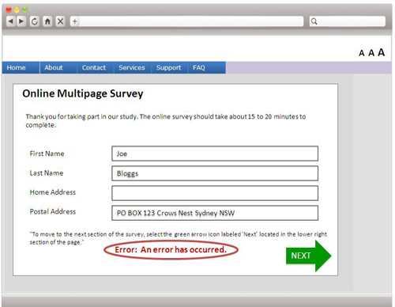
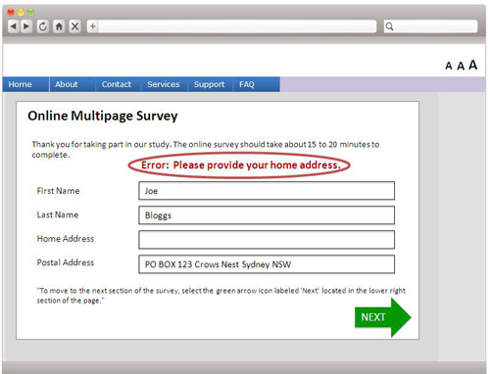
W11
((Silver Award)
11. Input Assistance
Provide input assistance such as proper labels for user input, error identification, description and suggestions etc.
  The error message is located at the bottom of the webpage and does not provide an adequate description of what needs to be corrected
  The error message is located at the top provides clear explanation of what needs to be corrected

Slide 31
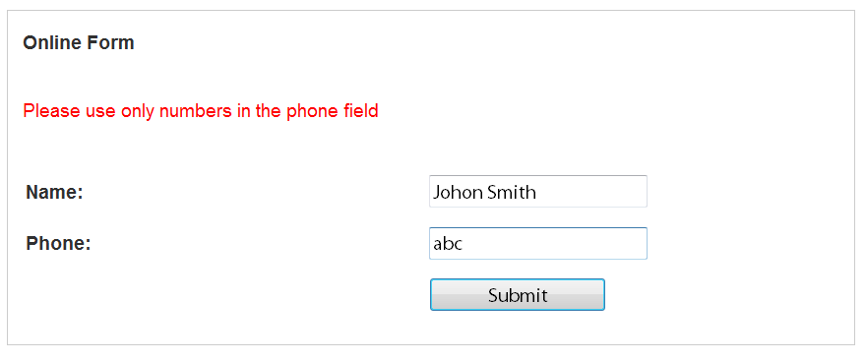
W11
((Silver Award)
11. Input Assistance
Testing: Manual Testing with Screen Reader

Slide 32
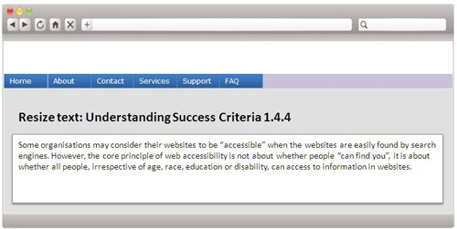
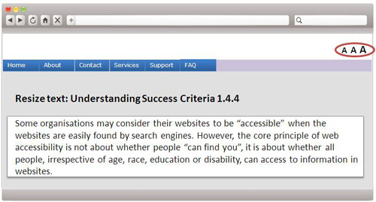
W12
((Silver Award)
12. Text Resize
Text can be resized up to 200 % without loss of content
  No text-resize function
  Text-resize function is available

Slide 33
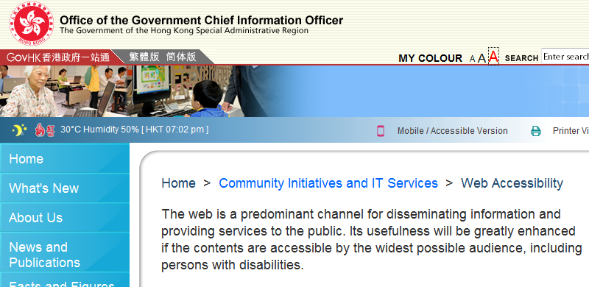
W12
((Silver Award)
12. Text Resize
Testing: Visual Review and Human Testing
Source : www.ogcio.gov.hk

Slide 34
W13
((Silver Award)
13. Accessibility Statement
Provide an accessibility statement with contact points for users when they encounter accessibility problems

Slide 35
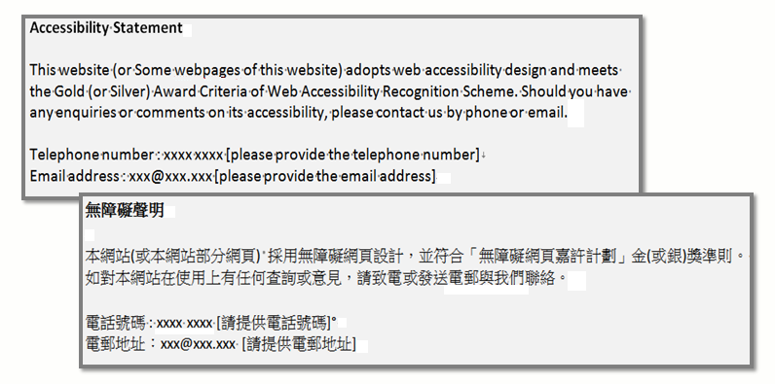
W13
((Silver Award)
13. Accessibility Statement
Testing: Visual Review

Slide 36

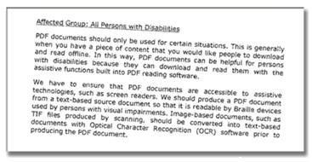
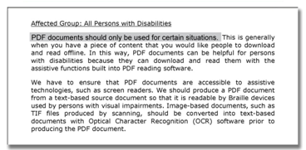
W14
(Gold Award)
14. Accessible PDFs
    Provide accessible PDFs
Scanned Image not accessible
Text-based accessible PDF

Slide 37
W14
(Gold Award)
14. Accessible PDFs
Testing: Manual Testing with Screen Reader
PDF Accessibility Checker (Free ) -
www.access-for-all.ch/en/pdf-lab/pdf-accessibility-checker-pac.html
Adobe Acrobat Accessibility Check (Paid)
www.adobe.com/accessibility.html

Slide 38
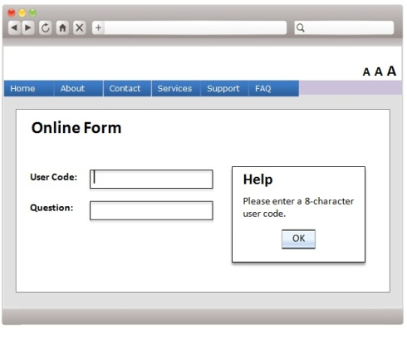
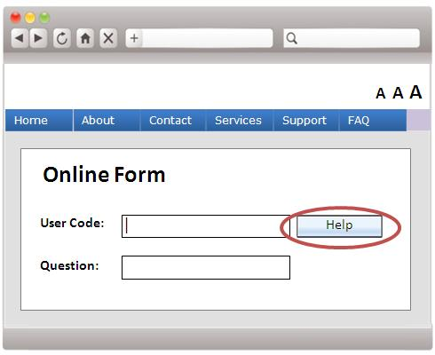
W15
(Gold Award)
15. Predictable Operations
    Build webpages with predictable operations
  A field receives focus, and a help dialogue box describing the field and providing options opens
  Allow the user to activate "Help" only at their choice

Slide 39
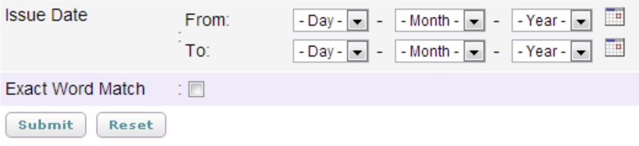
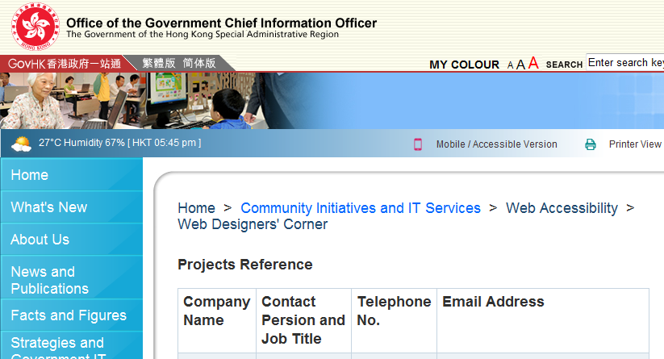
W15
(Gold Award)
15. Predictable Operations
Testing: Visual Review and Manual Testing with Screen Reader

Slide 40
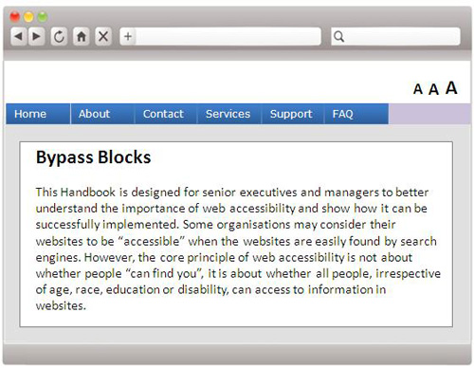
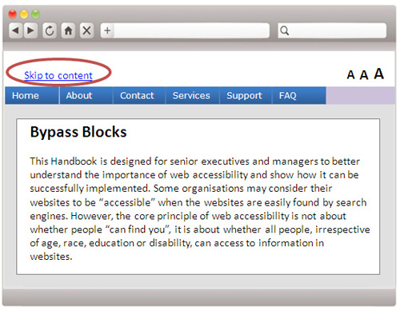
W16
(Gold Award)
16. Skip Repetitive Blocks
    Ensure users have the ability to skip past repetitive blocks of content (e.g. the navigation at the top of the webpage)
  People using screen readers need to read all the navigation information before getting to the target content
  Add a "Skip to content" link at the top of each webpage

Slide 41
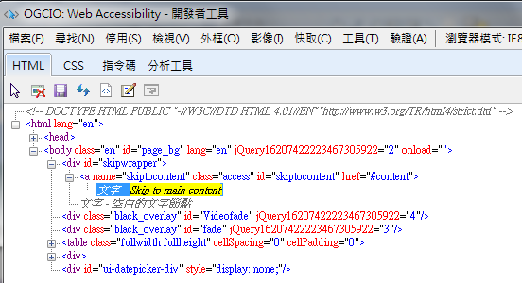
W16
(Gold Award)
16. Skip Repetitive Blocks
Testing: Visual & Code Review, Manual Testing with Screen Reader

Slide 42
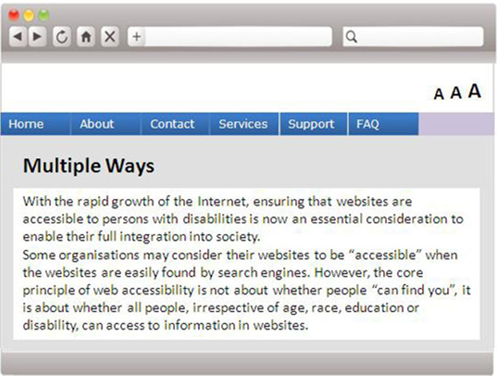
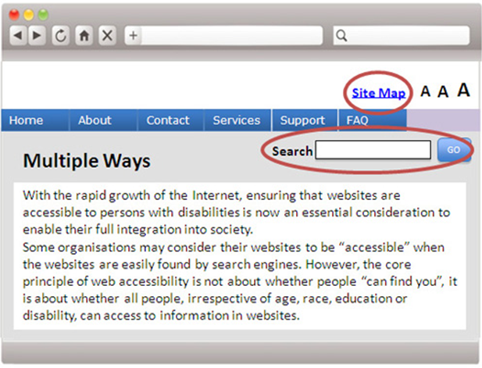
W17
(Gold Award)
17. Multiple Ways
    Provide more than one way to access a webpage such as using a search function, site map, standard navigation, etc.
  The only way to navigate around website is through the main navigation
  More than one way to navigate around website

Slide 43
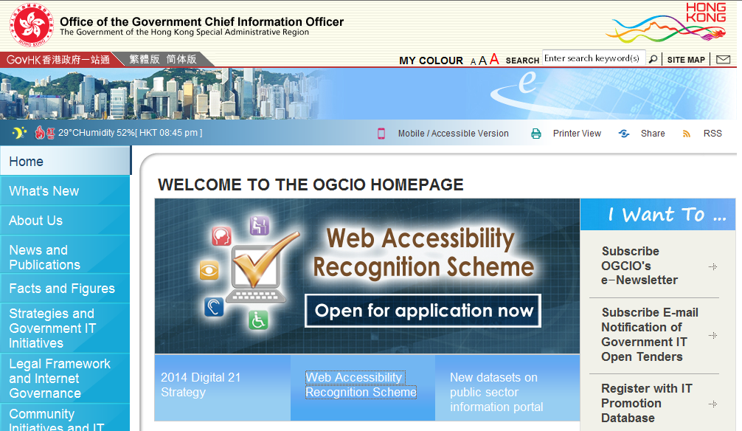
W17
(Gold Award)
17. Multiple Ways
Testing: Visual Review
Source : www.ogcio.gov.hk

Slide 44
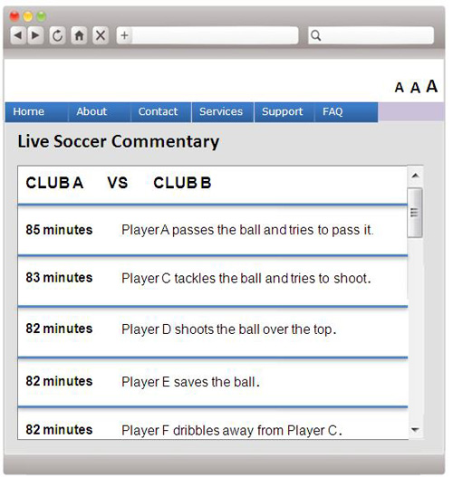
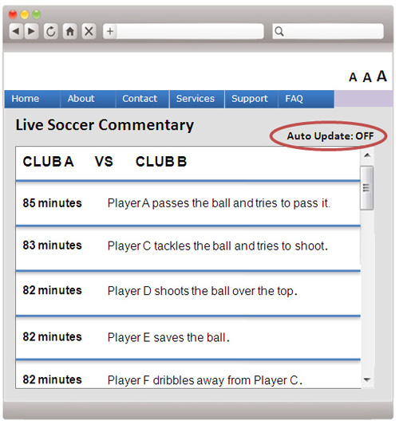
W18
(Gold Award)
18. User-initiated Auto-updating
    Allow the user to pause, stop or hide any moving information that starts automatically and lasts more than five seconds
  Update automatically as content changes
  Provide a function to turn off the auto updating

Slide 45
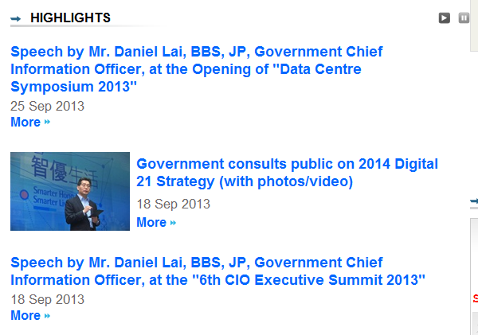
W18
(Gold Award)
18. User-initiated Auto-updating
Testing: Visual Review, Manual Testing with Screen Reader
Source : www.ogcio.gov.hk/en/news_and_publications/press_releases/
45

Slide 46
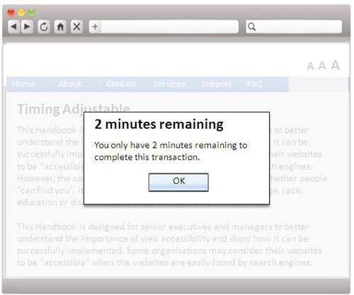
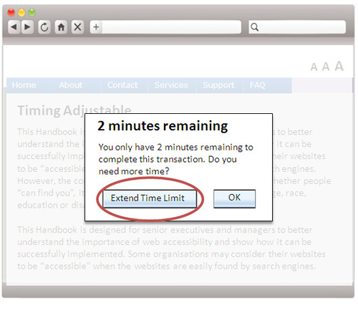
W19
(Gold Award)
19. Time-limited Function
Provide users enough time to read the content or operate the function
  Warn the user that time is about to expire
  Allow the user to extend the time

Slide 47

W19
(Gold Award)
19. Time-limited Function
Testing: Visual Review, Manual Testing with Screen Reader
Source : www.ogcio.gov.hk/en/community/web_accessibility/handbook/live_example/web_access_wcag_221.htm

Slide 48


W20
(Gold Award)
20. Sufficient Colour Contrast
The visual presentation of text and images of text has a contrast ratio of at least 4.5:1.
Logo or brand name is exempted
  Poor background contrast
  (2.74:1)
  Easier to read with higher contrast (21:1)

Slide 49


W20
(Gold Award)
20. Sufficient Colour Contrast
Testing: Colour Contrast Anaylser
www.paciellogroup.com/resources/contrastanalyser/

Slide 50


W21
(Gold Award)
21. Compatibility
Ensure correct syntax of webpages for compatibility with browsers and assistive technologies
  Incorrect syntax
  Correct syntax

Slide 51

W21
(Gold Award)
21. Compatibility
Testing: Code scanning
e.g. Achecker - achecker.ca/checker
WAVE –wave.webaim.org
Total Validator - www.totalvalidator.com

Slide 52

W22
(Gold Award)
22. Video
Testing: Visual Review
Source : www.ogcio.gov.hk/en/community/web_accessibility/recognition_scheme/video_gallery/

Slide 53
W23
(Gold Award)
23. Table Header and Data
Provide meaningful title, summary or description for table header as well as data
 |  | Monday to Friday
General Enquiry | 2582 4606 | 8:45 am to 12:45 pm 1:45 pm to 5:45 pm
Web Accessibility | 2582 6079 | 9:00 am to 1:00 pm 2:00 pm to 5:30 pm
No header and title for the table
Enquiry Information
Hotline | Telephone | Office Hours
General Enquiry | 2582 4606 | 8:45 am to 12:45 pm 1:45 pm to 5:45 pm
Web Accessibility | 2582 6079 | 9:00 am to 1:00 pm 2:00 pm to 5:30 pm
Provide meaningful header and column title for the table

Slide 54


W23
(Gold Award)
23. Table Header and Data
Testing: Visual Review, Manual Testing with Screen Reader

Slide 55


W24
(Gold Award)
24. Error Prevention
    Provide error prevention for transactions
  User is forced to place the order without a confirmation process
  Allow the user to first confirm and give him/her the option to change any of the details before the final submission

Slide 56


W24
(Gold Award)
24. Error Prevention
Testing: Manual Testing with Screen Reader
56

Slide 57
APPLY NOW!!
Application Deadline : 30 November 2015

Slide 58
Thank you!

